Slide 1
Unlocking the Potential of Therapeutics for Fibrosis & Oncology
Corporate Presentation – April 2021

Slide 2
Disclaimer
This document has been prepared by Nuformix plc (the "Company") and is being made available for the sole purpose of providing the recipients with background information about the Company. It does not constitute or form part of any offer or invitation to sell or issue or any solicitation of any offer to purchase or subscribe for any shares or other securities of the Company nor shall it (or any part of it), or the fact of its distribution, form the basis of, or be relied upon in connection with or act as any inducement to enter into, any contract or commitment whatsoever. This document is not a recommendation regarding the securities of the Company. Recipients should not purchase, subscribe for or otherwise acquire any securities of the Company on the basis of this document.
Forward-looking statements are sometimes identified by the use of forward-looking terminology such as "believe", "expects", "may", "will", "could", "should", "shall", "risk", "intends", "estimates", "aims", "plans", "predicts", "continues", "assumes", "positioned" or "anticipates" or the negative thereof, other variations thereon or comparable terminology. These forward-looking statements speak only as at the date of this document. In addition, all projections, valuations and statistical analyses provided in this document may be based on subjective assessments and assumptions and may use alternative methodologies that produce different results and should not be relied upon as an accurate prediction of future performance.
Except as required by applicable law or regulation, neither the Company nor any of its directors, officers, partners, employees, agents, affiliates, representatives or advisers ("Representatives") undertakes or agrees to any obligation to update or revise any forward-looking or other statements or information in this document, whether as a result of new information, future developments or otherwise and none of the Company or any of its Representatives or any other party undertakes or agrees or is under any duty to update this document or to correct any inaccuracies in, or omissions from, any such information which may become apparent or to provide you with any additional information. No statement in this document is intended as a profit forecast or profit estimate (unless otherwise stated). To the fullest extent permitted by applicable law or regulation, no undertaking, representation or warranty or other assurance, express or implied, is made or given by or on behalf of the Company or any of its parent or subsidiary undertakings or the subsidiary undertakings of any such parent undertakings or any of its Representatives, or any other person, as to the accuracy, sufficiency, completeness or fairness of the information, opinions or beliefs contained in this document. Save in the case of fraud, no responsibility or liability is accepted by any person for any errors, omissions or inaccuracies in such information or opinions or for any loss, cost or damage suffered or incurred, howsoever arising, directly or indirectly, from any use of, as a result of the reliance on, or otherwise in connection with, this document. In addition, no duty of care or otherwise is owed by any such person to recipients of this document. This document and its contents are confidential and you and your directors, officers, partners, employees, agents and affiliates shall treat and safeguard as strictly private and confidential all information contained in this document. You shall not use this document or the information contained herein in any manner detrimental to the Company.
If you have received this document electronically, you are reminded that documents transmitted via this medium may be altered or changed during the process of electronic transmission and, consequently, neither the Company nor any of its Representatives or any other person, accepts any liability or responsibility whatsoever in respect of any difference between the document distributed to you in electronic format and the hard copy version available to you on request. Please ensure that your copy is complete. You are responsible for protecting against viruses and other destructive items.
By receiving this document (whether in hard copy form or electronically), you irrevocably represent, warrant and undertake to the Company that you have read and agree to comply with, and be bound by, the contents of this notice.
To the extent available, the industry, market and competitive position data contained in this document has come from official or third party sources. Third party industry publications, studies and surveys generally state that the data contained therein have been obtained from sources believed to be reliable, but that there is no guarantee of the accuracy or completeness of such data. While the Company believes that each of these publications, studies and surveys has been prepared by a reputable source, the Company has not independently verified the data contained therein

Slide 3
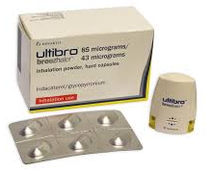
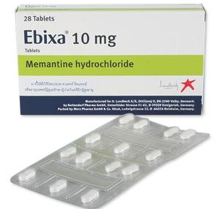
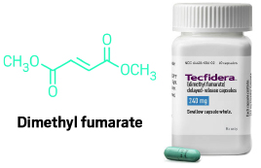
Expertise in Repurposing Allows Nuformix to Maximise Commercial Opportunities
Discovery, development and IP protection of new, differentiated uses of existing drugs
Enhancing the therapeutic potential and commercial value of drugs
Generating new Intellectual Property to add commercial value
New differentiated indications based on a strong scientific rationale
Focus is fibrosis and oncology, with application across a wide-range of indications
Potential advantages due to existing data, particularly safety
Greater probability of success
Faster clinical proof-of-concept
Lower development costs
Making a difference to patients
Dedicated to changing the lives of patients affected by diseases with high unmet medical needs
Examples of
repurposed drugs
Ultibro/Seebri Breezhaler:
License deal: $375m
2019 combined sales ~$548m
2013 sales (peak):
Ebixa (EU/RoW) - $340m
Namenda (US) - $1.52 bn
2019 sales $4.4 bn

Slide 4
Business highlights
Targeting fibrosis and oncology
Pipeline of Preclinical / Phase 1 ready assets with significant value potential and potential for early licensing opportunities
Lead asset NXP002 (inhaled tranilast) – novel inhaled candidate for idiopathic pulmonary fibrosis (IPF)
Additional assets: NXP001 and NXP004 for oncology
Innovative product concepts with commercial potential, addressing high unmet needs, with greater probability of success through repurposing

Slide 5
Highly Experienced Executive Leadership and Board (as at April 2021)
EXECUTIVE LEADERSHIP
Dr Anne Brindley
Chief Executive Officer
Over 30 years in Big Pharma and Biotech with extensive expertise in respiratory and oncology R&D, and business development including licensing and company sale
Key role in successful inhaled products – Symbicort® and flutiform®
Former CEO Advent / AuroScience Pty Ltd
Dr Joanne Holland
Chief Scientific Officer & a Co-Founder
Over 18 years experience in R&D, IP & commercial roles within the pharmaceutical Industry
Expert in pharmaceutical solid forms, cocrystals, process R&D and drug reprofiling (Millennium, Stylacats)
NON-EXECUTIVE DIRECTORS
Dr Karl Keegan
Non-Executive Director
Over 25 years in life sciences
CFO of e-therapeutics plc; Former roles as CEO, CFO, corporate development, M&A and sell-side analyst
Dr Julian Gilbert
Non-Executive Director
Over 30 years in pharma in commercial, technical and business development
Co-founder / former CEO of Acacia Pharma; Co-founder / Commercial Director of Arakis
Ms Maddy Kennedy
Non-Executive Director
Over 20 years of experience in life sciences including IPO, M&A, fundraising and strategic review as CFO

Slide 6
Nuformix Strategy
Unlocking the potential of therapeutics for fibrosis & oncology
Accelerate value creation through Business Development & Licensing
Optimise value from existing assets, with prioritised use of cash & tight financial control*
Progress further activities on NXP002 to deliver compelling data to increase asset value and attractiveness to partners/licensees
Further research on NXP004 for oncology and potential IP licensing opportunity
NXP001 licensing
* Includes ongoing non-dilutive grant funding applications

Slide 7
Business Model
Extensive drug development and repurposing expertise
Virtual development via strong network of contractors
Rigorous business development
Identify / create new product concepts
IP generation / Preclinical / early clinical development
Value inflexion point – licensing / partnering
Value added to Nuformix

Slide 8
Nuformix Pipeline
Project / indication / route of administration | IP generation | Preclinical | Phase 1
NXP002 IPF Inhaled tranilast
NXP001 Oncology Oral aprepitant (license option to Oxilio)
NXP004 Oncology Oral (undisclosed drug)
BD activity
BD activity

Slide 9
NXP002 (Inhaled Tranilast) in Idiopathic Pulmonary Fibrosis
Idiopathic Pulmonary Fibrosis (IPF)
NXP002 (Inhaled Tranilast)
Devastating, progressive disease caused by scarring (fibrosis) in the lung
Affects 3 million people worldwide, including 130,000 in the US – an Orphan Indication
Median survival time is 3-5 years
Approved antifibrotic drugs (pirfenidone and nintedanib) are only partially effective and have significant side-effects
Quality of life for end-stage disease is very poor
Potential novel inhaled treatment for IPF
Potential for Orphan Drug Designation
Tranilast originally marketed in Asia as oral drug for allergies; evidence supports its potential in fibrosis, including IPF
NFX discovered novel physical forms of tranilast
Enables re-purposing for delivery by inhalation to the target organ (lungs), potentially enhancing efficacy and minimising side-effects
Patent applications filed (one granted)
2 scenarios where an inhaled IPF treatment could add benefit to patients
Added to Standard of Care (SOC)
As monotherapy

Slide 10
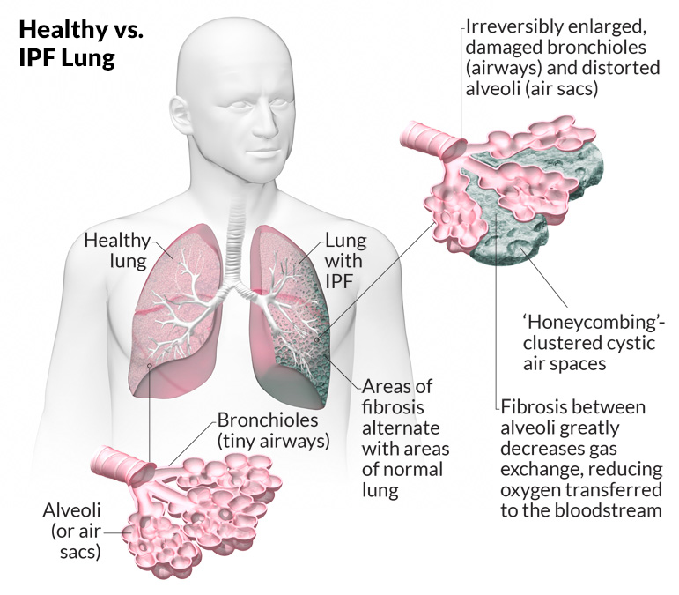
IPF Disease Process and Physiology
Smoke, pollution, acid
Death from respiratory failure (suffocation)
Lung tissue injury
Inflammation, excessive wound healing
Patients become breathless, wheelchair bound and require oxygen
Fibrosis, scarring
Reduced gas exchange

Slide 11
Significant Commercial Opportunity in IPF
Fast-growing market driven by orally delivered Ofev® (nintedanib) & Esbriet® (pirfenidone)
US launches 2014
Global Sales
Esbriet: 2020 CHF 1.108 bn (~USD 1.229 bn)
Ofev: 2019 EUR 1.491 bn (~USD 1.793 bn)
US Pricing²
$123k/year Esbriet
$135k/year Ofev
IPF market in 7 major markets¹: Largest market is US, followed by UK, Italy, Japan, Germany, France, Spain
Projected $4.3bn
8.4% CAGR
Total $1.5bn
2017
2030 estimated
1. Figures from DelveInsight IPF Market Insights, Epidemiology and Market Forecast – 2017 – 2030
2. Current wholesale acquisition price for 365 days per year treatment at recommended dosing regimen (RedBook)

Slide 12
IPF attracts many deals in early clinical stage and more recently in preclinical stage (1)
Licensee / deal type / asset | Acquirer / partner | Stage at time of deal | Data at time of deal | Value USD m incl upfronts | Upfront USD m
Morphic Therapeutics (licensing agreement) (MORF-720 & 627) | Abbvie 2018 – option Abbvie 2020 - license | Preclinical | Preclinical | undisclosed | 100 20
RedX (licensing option) (RXC006, Porcupine (Wnt) inhibitor) | AstraZeneca 2020 | Preclinical | Preclinical | 377 | 17 (up to positive Phase 1)
Galecto (acquisition option) (TD139: Galectin-3 Inhibitor) | BMS 2014 | Started first in human study | Safety/ PK in healthy subjects | 444
Bridge Biotherapeutics (licensing agreement) (BBT-877, Autotaxin inhibitor) | BI - 2019 | Phase 1 | Phase 1 | 1300 | 55 (upfront + near term)
OncoArendi (licensing agreement) (OATD-01, chitinase inhibitor) | Galapagos 2020 | Phase 1 | Phase 1 | 387 | 30
Samumed (license agreement) (SM04646, Wnt inhibitor) | United Therapeutics 2018 | Phase 1 | No information | 350 | 10
Stromedix (company acquired) (STX-100: AlphaVβ6 Integrin Antagonist) | Biogen 2012 | Phase 1 | Safety / PK in IPF | 562.5 | 75
Sources: Websites, press releases; clinicaltrials.gov

Slide 13
IPF attracts many deals in early clinical stage and more recently in preclinical stage (2)
Licensee / deal type / asset | Acquirer / partner | Stage at time of deal | Data at time of deal | Value USD m incl upfronts | Upfront USD m
Arresto (company acquired) (Simtuzumab: LOXL2 Inhibitor) | Gilead 2011 | In Phase 1 | Safety/PK in healthy subjects | 225
Amira (company acquired) (AM-152: LPA1 Antagonist) | BMS 2011 | End Phase 1 | No information | 475 | 325
Promedior (acquisition option) (PRM-151: rPentraxin-2) | BMS 2015 Roche 2020 | Phase 2 Phase 2 | Safety / PK in IPF Phase 2 data | 1,250 1,390 | 150 390
Galapagos (broad 10 year R&D collaboration / licensing / option deal on 6 clinical and 20 preclinical programs; includes GLPG1690, ziritaxestat, an autotaxin inhibitor for IPF) | Gilead 2019 | GLPG1690 in Phase 3 |  | $5.05 bn total deal value incl. $1.1bn equity + GLPG1690- specific $325m milestone | 3.95bn
InterMune (company acquired) (Pirfenidone) | Roche 2014 | Approved (US was pending) | Phase 3 data on lung function | 8,300
Sources: Websites, press releases; clinicaltrials.gov

Slide 14
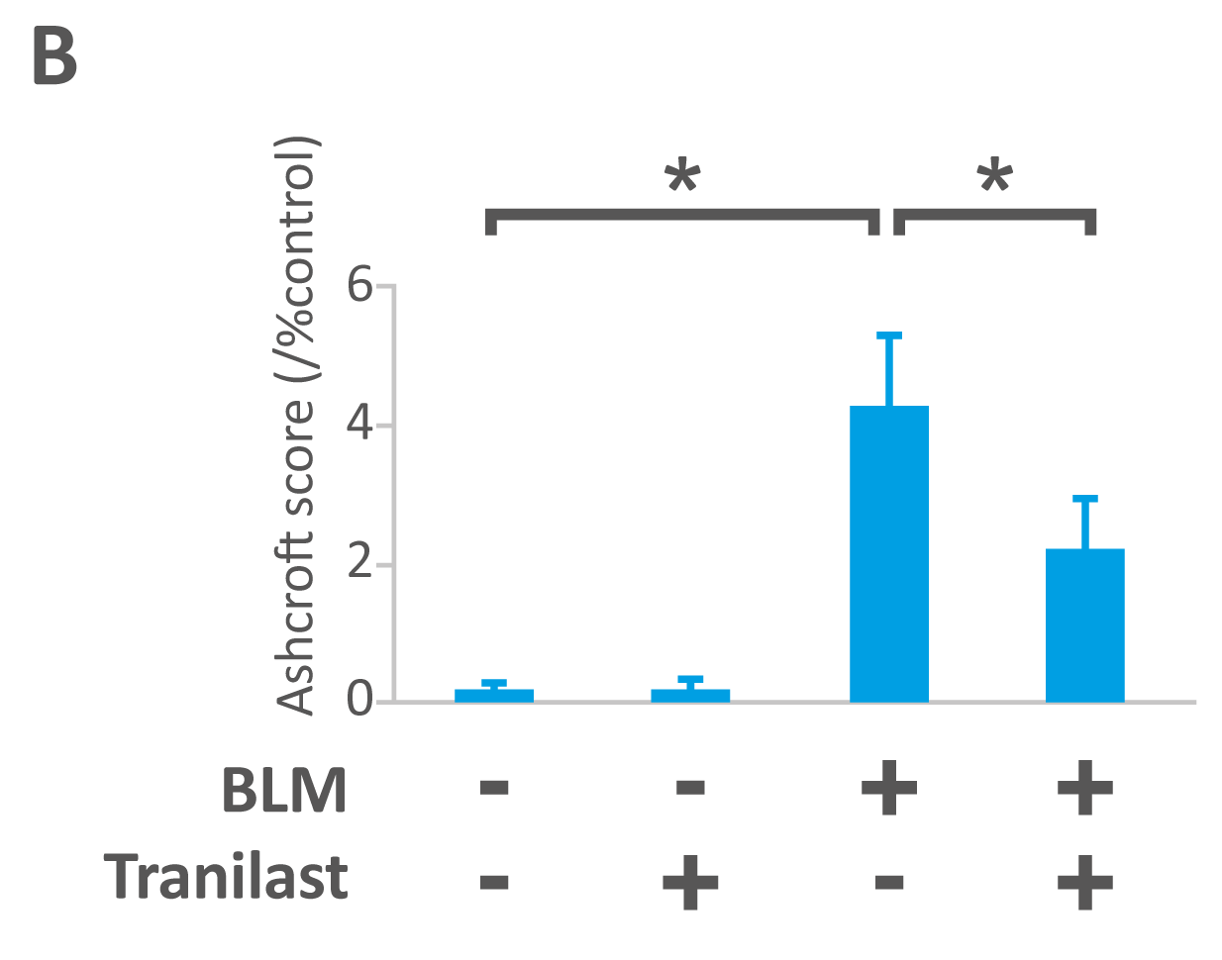
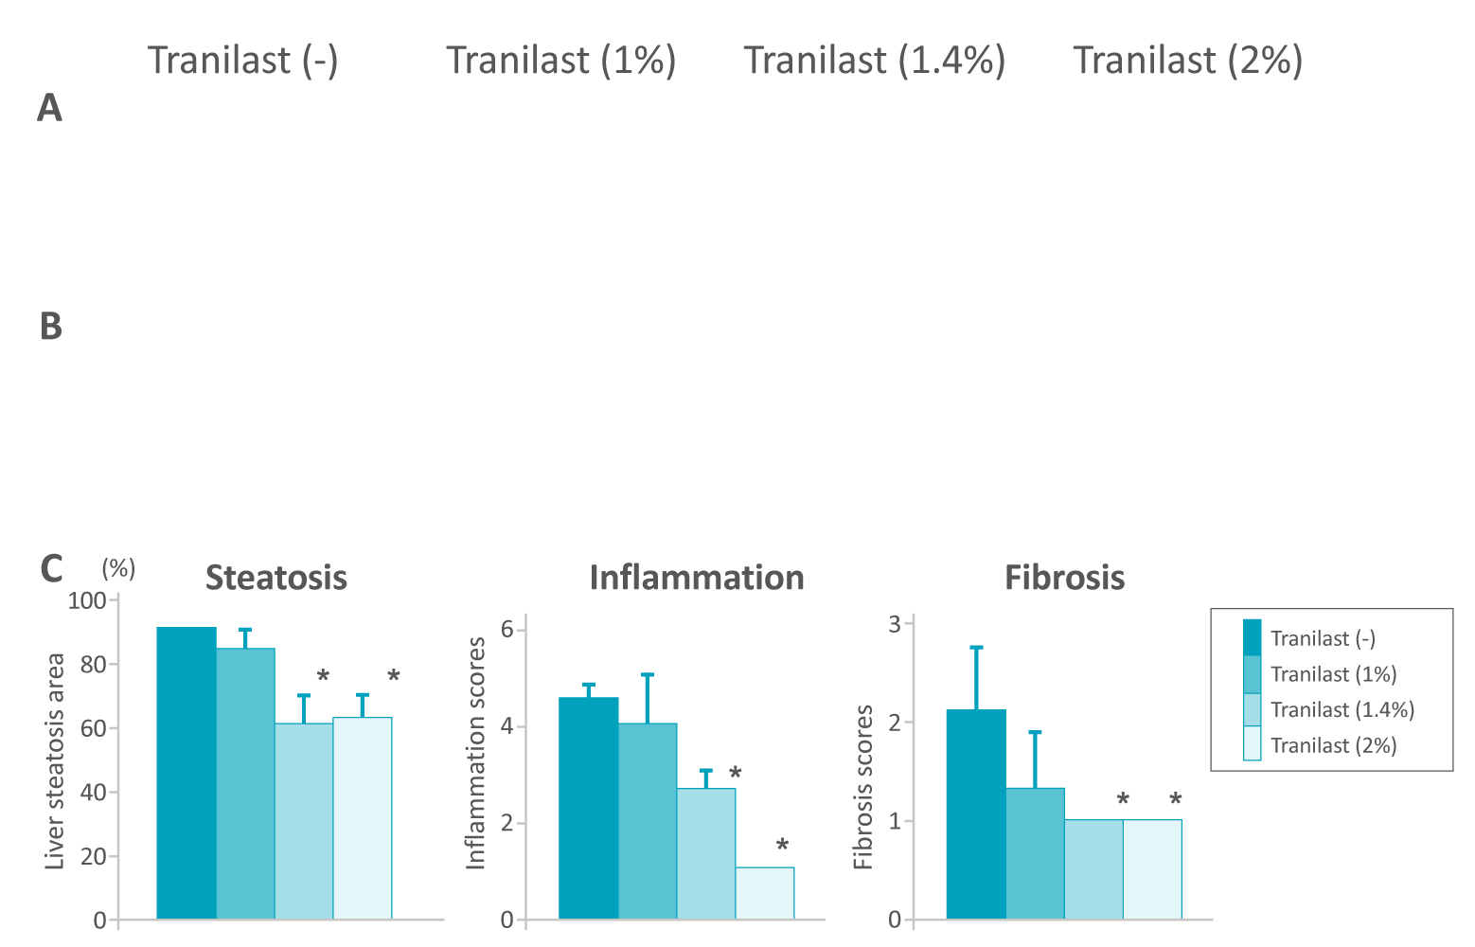
Preclinical Data Supports Potential of Tranilast in IPF
Literature data in numerous models supports use of tranilast in fibrosis
Oral tranilast bleomycin (BLM) study (mouse) - model for IPF¹
Tranilast in NASH model of liver fibrosis²
NFX data on NXP002 also supports its use in IPF - demonstrated that tranilast reduces fibrosis and inflammation markers in human lung tissue taken from IPF patients
1. Kato et al; Drug Design, Development and Therapy 2020:14
2. Uno et al; Hepatology July 2008

Slide 15
NXP002 (Inhaled Tranilast) – Development Plan
Q1
Q2
Q3
Q4
Q1
Q2
Q3
Q4
Q2
Q3
Q4
Q1
2021
2022
2023
PRECLINICAL
PHASE 1
PHASE 2
Inhalation
Feasibility
Non-GLP
GLP
Phase 1
Today
Feasibility
package
Non-GLP package
Phase 1 ready package
Phase 1
package
Development related inflexion points offer multiple licensing opportunities along the development pathway
Decreasing Risk / Increasing Value
Licensing opportunities
GLP: Studies performed according to Good Laboratory Practice

Slide 16
NXP001 (aprepitant)
Marketed drug
NXP001
Oral drug for Oncology Supportive Care
Poor physical properties, needs complex formulation
Literature data on potential in other indications e.g. oncology
Novel form with improved properties
Granted patent attained
NFX data from Phase 1 study demonstrates bioavailability without complex formulation
Oxilio exercised option to license* for repurposing in oncology
*Oxilio exercised (March 2021) option and now working together to finalise a global licensing agreement for NXP001; upfront payment, development milestones and royalties capped at £2m p.a

Slide 17
NXP004
Marketed drug
NXP004
Oral drug with blockbuster sales and growth for Oncology
Poor physical properties, needs complex formulation
Patent protected formulation until early/mid 2030s
Novel form with improved properties
Further research ongoing to characterise and elucidate advantages
One patent application filed – if granted, potential expiry ~2040; 2nd application pending
2 options for licensing IP to generate value
License to Originator to potentially extend patent protection and add significant value
License to generic companies to potentially allow commercialisation of generic alternative

Slide 18
Recent Successful Placing and Use of Funds
Placing
Equity placing raised c.£1.5m gross (March 2021)
Use of funds
Develop preclinical data package for lead asset NXP002
Staged investment approach with several options to license
NXP004 – further research followed by business development
Additional working capital

Slide 19
Summary
Focus
New therapies with attractive commercial potential in fibrosis and oncology
Assets
Potential to derive value in the short-term through further development and /or BD and licensing
Management
Strengthened leadership with extensive and relevant experience
Low cost base
Fully virtual operating model with a broad network of contractors

Slide 20
Appendices

Slide 21
Company Summary
Founded in 2008 and listed on London Stock Exchange (LSE: NFX) in 2017
Fully virtual operating model with low operating costs
Market Cap (April 2021)
c.£14m
Substantial shareholders (April 2021 figures):
CPI Enterprises¹ 6.7%
Dr DJ Gooding² 6.3%
Dr JM Holland³ 6.3%
Mr A Chorlton⁴ 4.1%
Mr J Higgins⁵ 3.5%
Brief financials (H1 2020)
Total revenue £195,550 (H1 2019: £535,000)
Loss before tax £475,874 (H1 2019: loss of £131,842)
Loss on ordinary activities (after tax credit) of £474,659 (H1 2019: loss of £131,842)
Loss per share 0.10p (H1 2019: 0.03p)
Net assets £4,301,236 (30 September 2019: £3,980,126) including £216,412 cash and cash equivalents (30 September 2019: £132,764)
Source: ¹TR1 (30/3/21); ^{2,4 & 5} LINK registrars (29/3/21); ³TR1 (6/4/21)

Slide 22
Repurposing examples – deals
Company | Drug | Repurposed indication | Original indication | Product change from original | Acquirer/Licensor (Year) | Stage at time of deal | Deal Value (USD) | Upfront (USD)
Vicept Therapeutics | Rhofade (oxymetazoline) | Rosacea (topical cream) | Decongestant (nasal spray) | New indication + route | Allergan (2011) | Phase II complete | 200 million (acquisition) | 75 million
Arakis (Sosei)/ Vectura | Seebri/Ultibro (glycopyrronium) | COPD (inhaled) | Ulcers/Excessive sweating (Oral/IV) | New indication + route | Novartis (2005) | Phase II | 375 million | 30 million (15 m each – Arakis & Vectura)
Aspreva Pharma | Cellcept (mycophenolate) | Lupus nephritis (oral) | Immunosuppressant (oral) | New indication | Galenica Holdings (2008) | Phase III ongoing | 915 million (acquisition)
Ceptaris Therapeutics | Valchlor (mechloroethamine) | Lymphoma (oral) | Mustard gas (chemical warfare) | New indication + formulation | Actelion (2013) | On approval | 250 million (acquisition)
Esteve | celecoxib+tramadol combination | Severe acute pain | Individually marketed for mild to moderate pain | New indication + new cocrystal form | Mundipharma (2015) | Phase 2 complete | >1 billion (second asset included)
New River | Vyvanse (lisdexamfetamine dimesylate) | ADHD | Originally marketed as mix of 4 amphetamine salts (Adderall) | New prodrug form | Shire (2007) | Phase III ongoing | 2.6 billion (acquisition) | 50
Medivation | Dimebon (latepiridine) | Alzheimers | Antihistamine (Russia only) | New indication, new geography | Pfizer (2008) | Phase II | 725 million | 225
Nektar Therapeutics | Movantik (PEGylated naloxol) | Opioid induced constipation | IV for opioid overdose (as parent drug naloxone) | Pegylated form of drug | AstraZeneca (2009) | Phase II complete | 735 million | 125
Novartis | TOBI Podhaler and liquid (tobramycin) | Cystic Fibrosis (inhaled) | Antibiotic (IV) | New indication + route | Mylan (2018) | Marketed | 463 million

Slide 23
Repurposing examples – products
Company | Drug | Repurposed indication | Original indication | Product differentiation | Annual revenues (USD) | Notes
Biogen | Tecfidera (dimethylfumarate) | Multiple Sclerosis | Psoriasis (topical) | New route (oral) | 4.43 billion (2019)
Acacia | Barhemsys (amisulpride) | Post operative nausea and vomiting | Schizophrenia (oral) | New route (IV) | 400 million (predicted)
Allergan | Latisse (bimatroprost) | Hypotrichosis (eyelash growth) | Glaucoma | New indication | 200 million (at peak) | Same route as original (eyedrops)
Allergan | Botox (onabotulinumtoxinA) | Wrinkles, chronic migraine, urinary incontinence, hyperhidrosis | Strabismus | New indication | 3.79 billion (2019) | Acquired from originator for $9million
Celgene | Thalidomide | Oncology | Morning sickness | New indication | 500 million (at peak)
Teva | Austedo (deutetrabenazine) | Huntington’s disease | Excessive movement disorders (tetrabenazine) | New indication using deuterated form | 412 million (2019)
Lundbeck / Allergan | Ebixa / Namenda (memantine) | Alzheimer’s disease | Muscle relaxant | New indication | EU 0.34 million US 1.52 billion

